Slide 1
YOUTUBE – COMMENT -SENTIMENT - ANALYSIS
Submitted to
Prof. Lesh Miraj

Slide 2



GROUP -5- TEAM
Yakshita Rakholiya
Bansari Sorathiya
MS IN COMPUTER SCIENCE
MS IN COMPUTER SCIENCE
Rishika Rachel M
Piyush Gupta
Huzefa Sadikot
MS IN DATA SCIENCE
MS IN DATA SCIENCE
MS IN COMPUTER SCIENCE

Slide 3
CONTENT
Introduction
Problem Statement
Objectives
Data Collection
Sentiment Analysis
Visualizations
Conclusion
API Used- (YouTube data API V3)
Data Pre Processing

Slide 4
INTRODUCTION

Slide 5
YouTube has over 2.5 billion monthly active users, making it the second largest social media/entertainment platform in the world after Facebook.
Users upload over 500 hours of video content on YouTube every minute, providing a vast amount of information to analyze.
Analyzing user behavior on certain YouTube channels (such as likes, comments, tags, and video titles) can provide insights into how viewers perceive the content and what changes can be made to improve it.
During the COVID-19 pandemic, YouTube viewing traffic increased significantly due to restrictions forcing people to stay at home.
The extended viewing time generated a large user base and revenue, motivating many people to pursue YouTube as a career option.
INTRODUCTION

Slide 6

Sentiment analysis is crucial for understanding user engagement on YouTube
YouTube is a significant source of user-generated content and opinions
Analyzing the sentiment of YouTube comments can be challenging due to the large amount of data
Manual research can be time-consuming and inefficient
Determining the sentiment of comments that use sarcasm or irony can be difficult
An automated system is needed to efficiently and accurately analyze the sentiment of YouTube comments
Such a system would enable researchers to gather valuable insights into public opinion and user engagement on the platform
Data-driven decisions and effective strategies can be developed based on these insights.
PROBLEM STATEMENT

Slide 7
The project aims to create an automated sentiment analysis system for YouTube comments
The system will be accurate, efficient, and easy to use
The model will be trained on a large and diverse dataset of YouTube comments
The dataset will be pre-processed using NLP techniques
The web application will allow users to select a YouTube channel and a date range for sentiment analysis
The results will be displayed in an intuitive format, including visualizations and charts
The objective is to provide a tool for analyzing public opinion and user engagement on YouTube
The system will help organizations make data-driven decisions and develop effective strategies based on YouTube comment sentiment.
OBJECTIVES

Slide 8
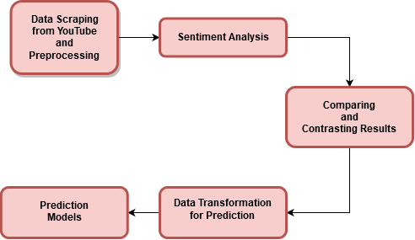
FLOW CHART

Slide 9
LIBRARIES USED

Slide 10
googleapiclient.discovery: Google API client library to access various Google APIs, such as Google Sheets or Google Drive.
pandas: A powerful data manipulation and analysis library, providing data structures like DataFrames and Series.
os: A module for interacting with the operating system, like reading from or writing to the file system.
numpy: A library for working with numerical data, supporting arrays, matrices, and various mathematical functions.
Json: A library for working with data in JavaScript Object Notation (JSON) format.Statistics: A library for performing statistical operations and calculations in Python.
Itertools: A library for creating and manipulating iterators and iterable objects in Python.Time: A library for working with dates, times, and time intervals in Python, including functions for measuring and benchmarking execution times.
LIBRARIES USED

Slide 11
Data visualization packages:
seaborn: A statistical data visualization library built on Matplotlib that provides a high-level interface for drawing informative and attractive graphs.
matplotlib.pyplot: A plotting library for creating static, animated, and interactive visualizations in Python.
matplotlib.ticker: A module for customizing tick locators and formatters in Matplotlib plots.
LIBRARIES USED
NLP:
nltk: A library for working with human language data (text), providing tools for text processing, classification, tokenization, stemming, tagging, and parsing.
nltk.corpus.stopwords: A module containing a list of common words that can be filtered out when processing natural language data.
nltk.tokenize: A module for breaking up text into words, phrases, symbols, or other meaningful elements (tokens).
wordcloud: A library for creating word cloud visualizations from text data.
Keras: A library used for artificial neural networks and as a prerequisite for TensorFlow.

Slide 12
USER-DEFINED FUNCTIONS:
Extractcomments(ec): Extracts comments from each videos.
Sentiment_vader(sv): Calculates sentiment score for each comment.
Visualizations(vis): Plots visualizations.
Getvideoids(fid): Gets video id for each video.
Getvideostatistics(vs): Gets statistics such as likes, comments for each video.
Predictionmodels(pred): Predicts like or dislike ratio using vader polarity score & defines baseline vader model; we also use linear regression.
Createtimeseriesdata(ctsd): Grouped data using date.
Predictiontimeseriesmodel(ptsm): We use LSTM model to predict future sentiment using time series data.
LIBRARIES USED

Slide 13
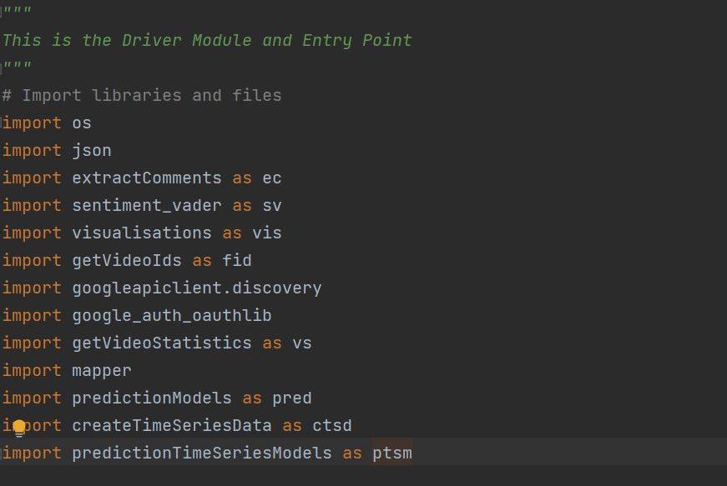
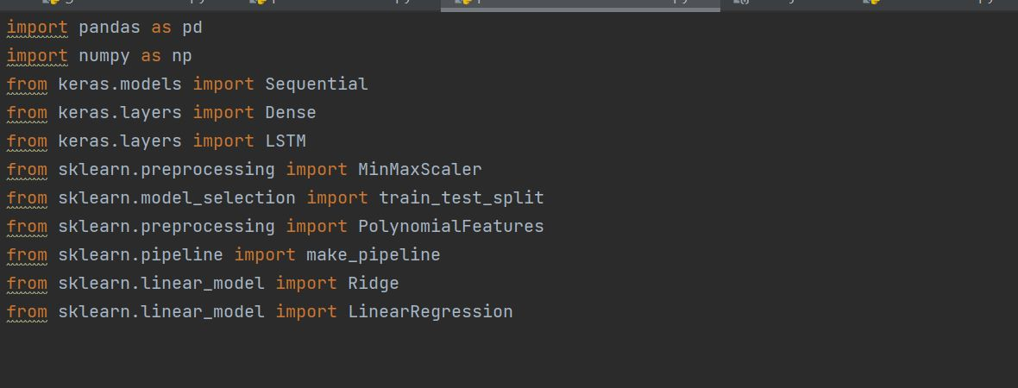

Slide 14
DATA COLLECTION

Slide 15
First, an authorized connection to the YouTube API is established using API keys obtained from Google Cloud Console.
The user is prompted to enter the name of the YouTube channel they wish to collect comments from.
The program sends a request to the YouTube API to retrieve the channel ID using the requestChannelId function, which takes the YouTube object and the channel name as input parameters.
The program fetches the video IDs of the latest videos uploaded by the channel using the getVideos function, which takes the YouTube object, channel ID, and the maximum number of videos to retrieve as input parameters.
DATA COLLECTION

Slide 16
DATA COLLECTION
The program then fetches the video IDs of the next set of videos using the getNextPageVideos function, which takes the YouTube object, channel ID, the nextPageToken parameter, and the maximum number of videos to retrieve as input parameters.
The program stores the fetched video IDs in a JSON file named <Channel Name>_vidlist.json in the comments folder.

Slide 17
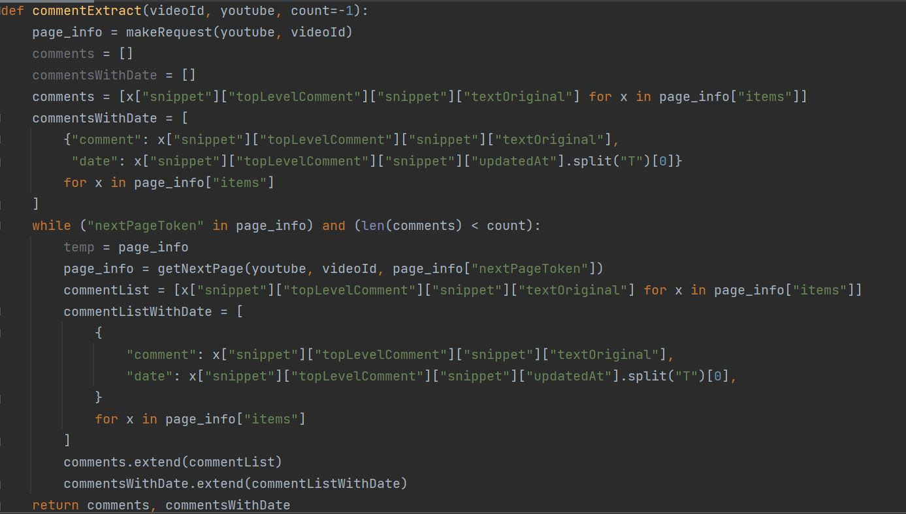

Slide 18
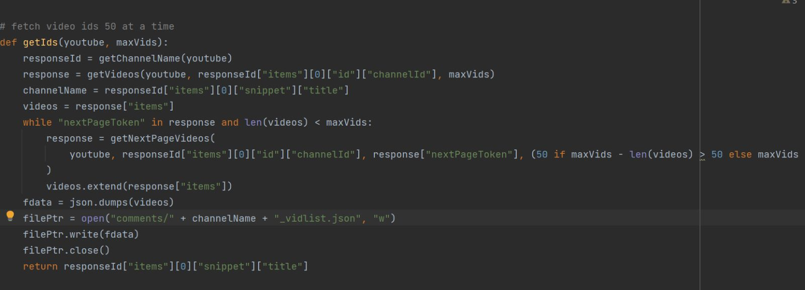

Slide 19
Cleaning the data: Removing unwanted characters, such as punctuation, special characters, or URLs from comments.
Tokenization: Splitting a string into a list of individual words using a tokenizer such as the NLTK tokenizer.
Stop words removal: Removing common words in a language that are not useful for text analysis to improve accuracy.
Stemming or lemmatization: Reducing inflected or derived words to their base or root form to improve accuracy.
Vectorization: Converting preprocessed comments into numerical vectors using Bag of Words (BoW) or Term Frequency-Inverse Document Frequency (TF-IDF).
Normalization: Scaling the values of the vectorized data to a common range to ensure that features with larger values do not dominate the analysis process.
Overall, data preprocessing is essential to ensure accurate and reliable sentiment analysis results for YouTube comments.
DATA PRE PROCESSING

Slide 20
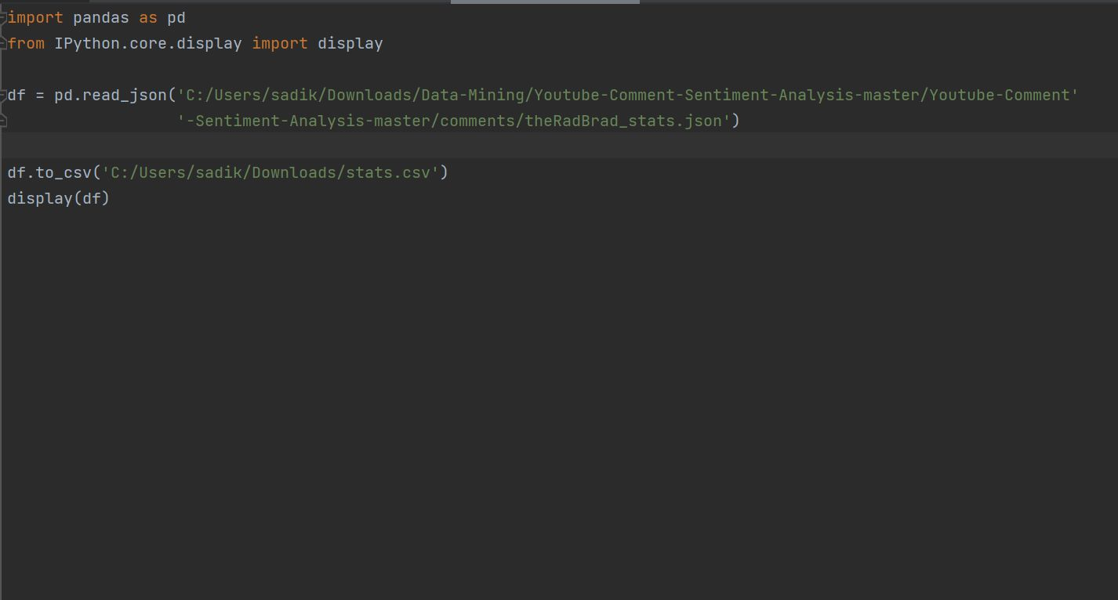
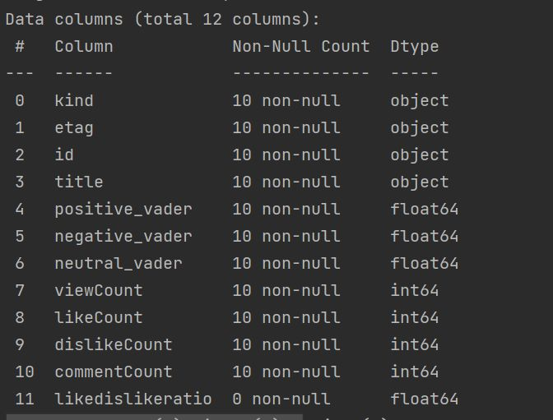

Slide 21
API USED – YOUTUBE DATA API v3

Slide 22
API USED
To use the YouTube Data API, you need to create a project in the Google Developers Console
This requires a Google Account, API key, and application registration
Obtain authorization credentials to submit API requests on behalf of your application
Ensure that the YouTube Data API is one of the services your application is registered to use
Enable the YouTube Data API v3 in the list of available APIs
Read the authentication guide for implementing OAuth 2.0 authorization if your application requires user authorization
Select a client library to simplify your API implementation in your preferred programming language
JSON is a common data format for storing and exchanging data in your application
Refer to the official YouTube Data API documentation to gain valuable insights into user engagement on the platform.

Slide 23
SENTIMENT ANALYSIS

Slide 24
MODELS USED - VADER
Lexicon and rule-based sentiment analysis, which is specifically attuned to sentiments expressed in social media. It works on a complete sentence analyzing text in addition to punctuations and emojis.
Vader uses a lexicon and rule-based approach to sentiment analysis, where the lexicon contains a list of words with their corresponding sentiment scores, and the rules provide additional context and adjust the sentiment score based on linguistic features such as punctuation and capitalization.
Vader's lexicon is designed to capture not only the polarity (positive or negative) of the sentiment but also the intensity and the valence of the sentiment (positive, negative, or neutral). The sentiment score ranges from -1 (most negative) to +1 (most positive), with 0 representing a neutral sentiment.
In addition to its lexicon-based approach, Vader also considers the influence of intensifiers, negations, and other features that can modify the sentiment of a sentence. This makes it especially effective in analyzing social media content, which often contains irony, sarcasm, and other non-literal expressions that can be challenging for traditional sentiment analysis approaches.
Overall, Vader is a powerful tool for sentiment analysis in social media content, providing accurate and nuanced insights into the sentiment of text data. It is widely used in various applications, including brand monitoring, customer feedback analysis, and political analysis.

Slide 25
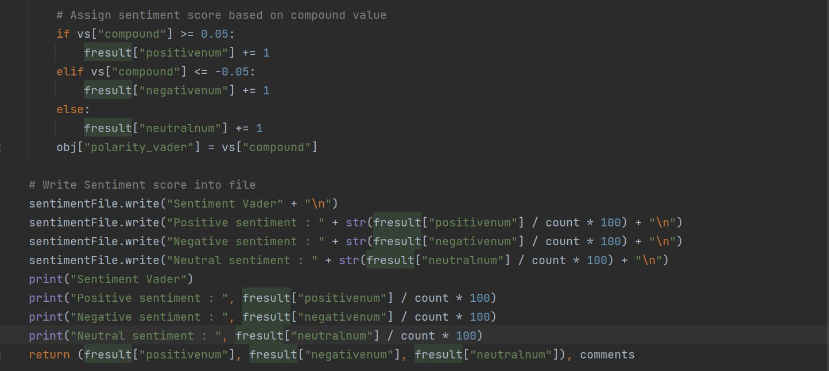

Slide 26
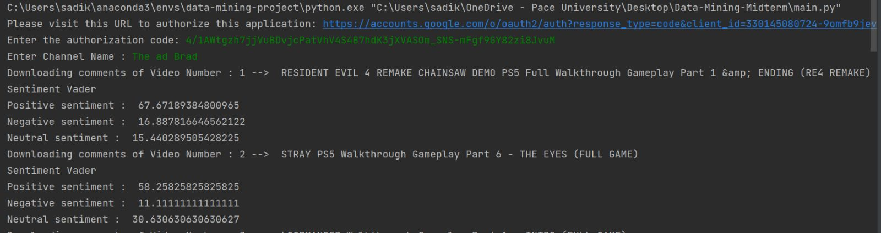

Slide 27
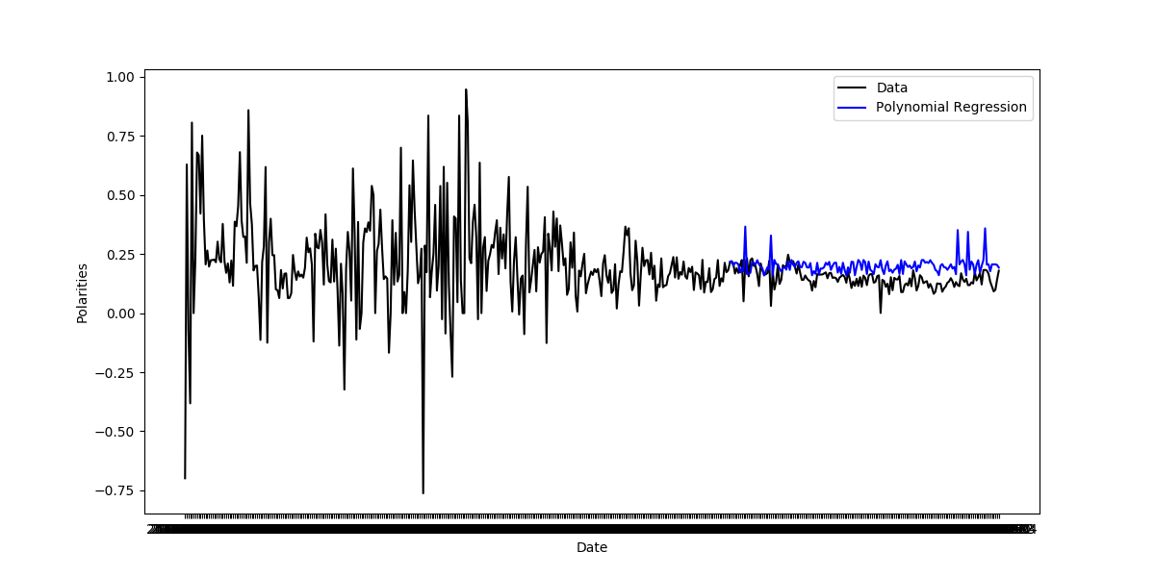

Slide 28
MODELS USED - AFINN
AFINN is a sentiment lexicon that rates English words for valence, with values ranging from -5 (negative) to +5 (positive).
YouTube comment sentiment analysis using AFINN involves tokenizing comments, scoring each word using the AFINN lexicon, and then calculating the sentiment score for the comment by summing up the valence values of the words.
The sentiment score is then normalized to a range between -1 and 1, with -1 being the most negative sentiment and 1 being the most positive sentiment.
The sentiment scores can be interpreted to understand the sentiment of the YouTube comments, with scores close to 1 indicating positive sentiment, scores close to -1 indicating negative sentiment, and scores close to 0 indicating neutral sentiment.
YouTube comment sentiment analysis using AFINN can provide valuable insights into how viewers feel about a particular video or topic.

Slide 29
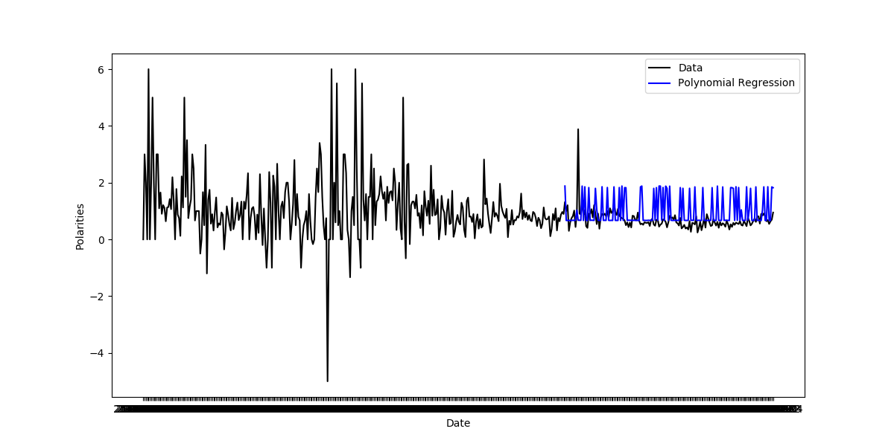

Slide 30
MODELS USED – NRC Lexicon
The NRC Emotion Lexicon is a list of English words rated for their association with eight basic emotions: anger, fear, anticipation, trust, surprise, sadness, joy, and disgust.
YouTube comment sentiment analysis using the NRC lexicon involves tokenizing comments, scoring each word using the NRC Emotion Lexicon, and then calculating the sentiment of the comment by summing up the number of words associated with each of the eight emotions, as well as positive and negative sentiment.
The sentiment scores can be normalized to a range between -1 and 1, where -1 is the most negative sentiment and 1 is the most positive sentiment.
The sentiment scores can be interpreted to understand the sentiment of the YouTube comments, with a high score for joy indicating positive sentiment, and high scores for anger or disgust indicating negative sentiment.
Using the NRC Emotion Lexicon to conduct sentiment analysis on YouTube comments can provide a more nuanced understanding of the emotional content of the comments, but it requires more computational resources compared to AFINN, and the lexicon may not accurately capture the sentiment of all comments.

Slide 31
WHICH MODEL IS BETTER:
Afinn: Afinn is a lexicon-based sentiment analysis tool that uses a list of words with positive and negative sentiments to analyze the sentiment of a text. It assigns a score to each word in the text based on the sentiment it conveys, and then calculates the sentiment score for the entire text based on the sum of these scores. Afinn is relatively simple and easy to use, but it may not perform as well as other tools in some cases.
Vedar: Vedar is a rule-based sentiment analysis tool that uses a set of rules to analyze the sentiment of a text. The rules are based on patterns and relationships between words, and they are designed to capture more complex aspects of sentiment than simple positive and negative word lists. Vedar is more complex than Afinn and may require more expertise to use effectively, but it can be more accurate in some cases.
NRC Lexicon: The NRC Lexicon is a lexicon-based sentiment analysis tool that uses a list of words with eight different emotions (anger, fear, anticipation, trust, surprise, sadness, joy, and disgust) to analyze the sentiment of a text. It assigns a score to each emotion for each word in the text, and then calculates the sentiment score for the entire text based on the sum of these scores. The NRC Lexicon is more complex than Afinn but may be more accurate in capturing the nuanced emotions in a text.
Overall, the choice of sentiment analysis tool will depend on the specific needs and goals of the project. Afinn may be a good choice for simple sentiment analysis, while Vedar and the NRC Lexicon may be better suited for more complex sentiment analysis tasks.

Slide 32
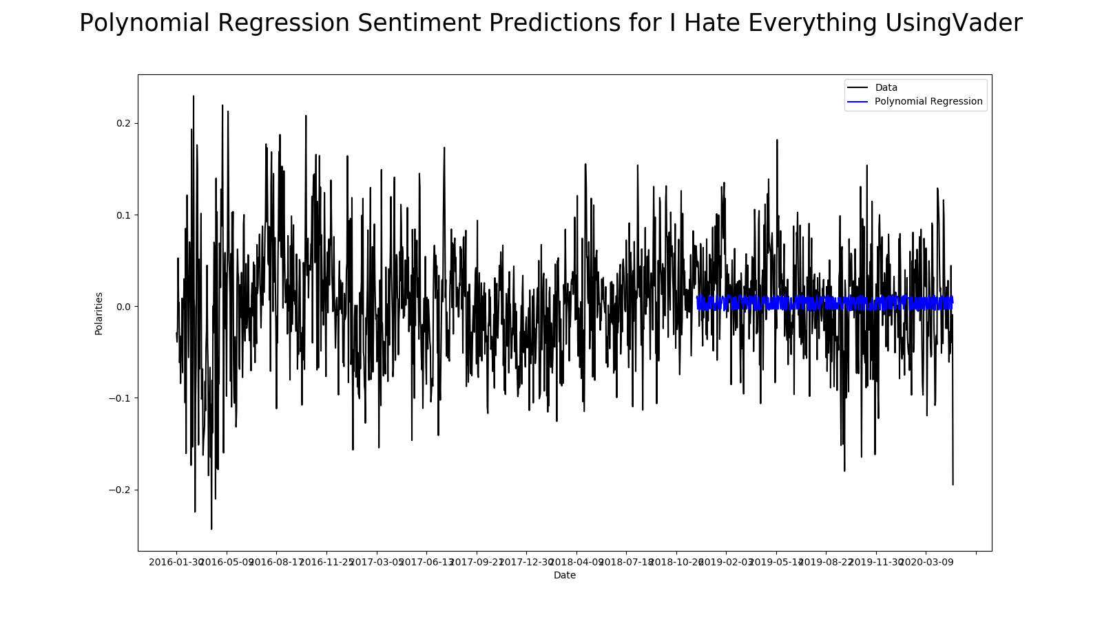
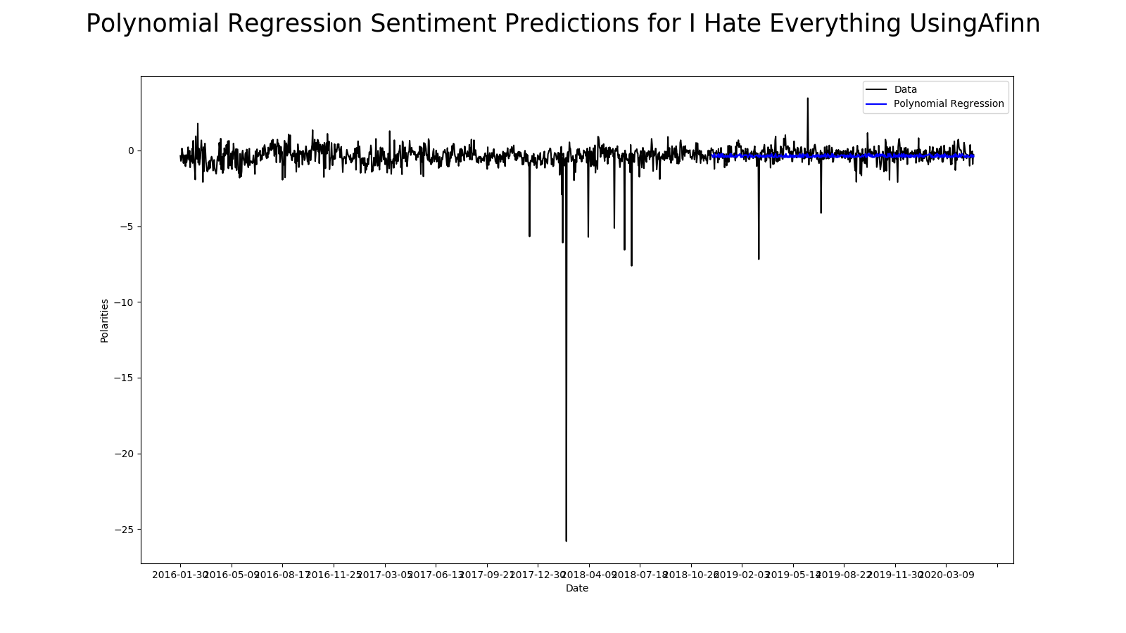

Slide 33
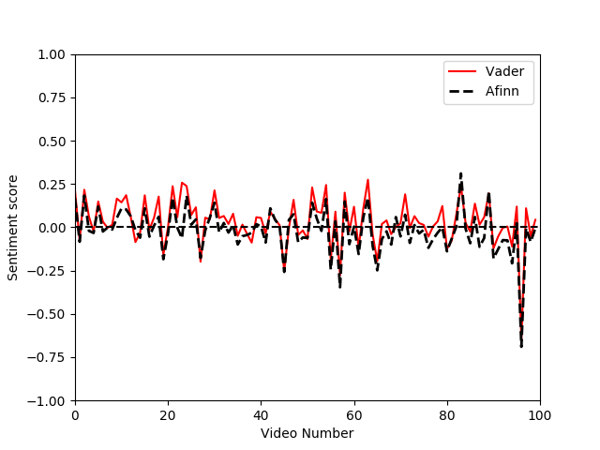

Slide 34
VISUALIZATIONS

Slide 35
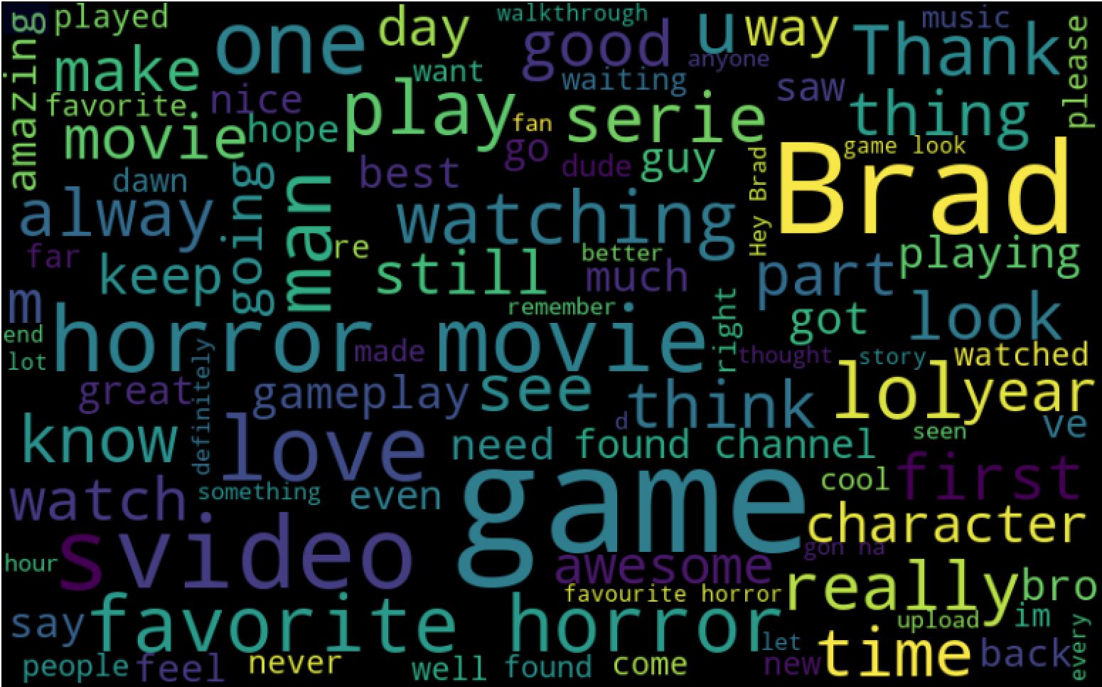
WORD CLOUD

Slide 36
CREDENTIALS

Slide 37
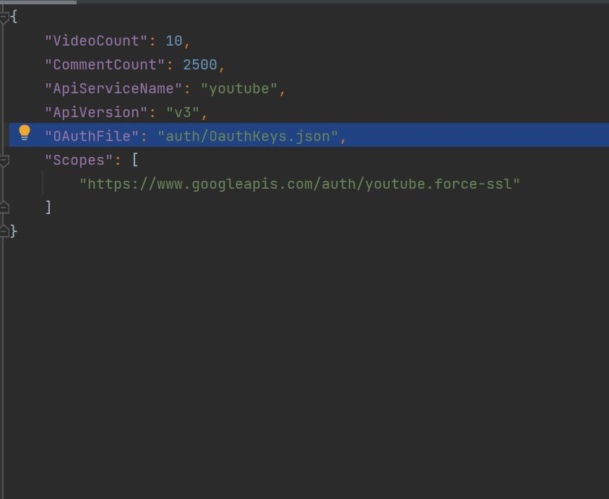

Slide 38
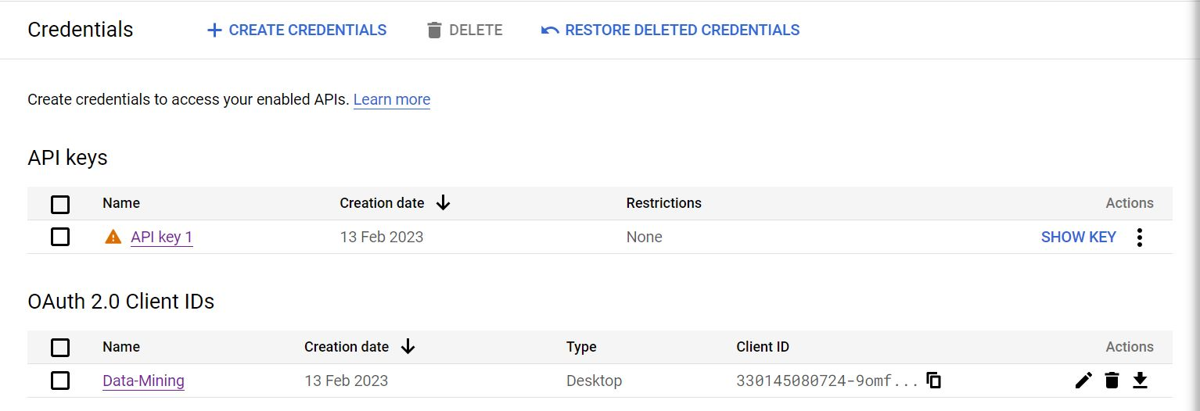

Slide 39
CONCLUSION

Slide 40
The project aims to create a tool for YouTube channel owners, content creators, and marketers to gauge viewer sentiment
The sentiment analysis system will be trained on a large and diverse dataset of YouTube comments, including sarcasm or irony
The project will provide a user-friendly web application for real-time sentiment analysis
The application will provide a visual representation of the sentiment of comments for identifying trends and patterns
The sentiment analysis project has the potential to revolutionize YouTube channel management and optimization
Valuable insights into viewer sentiment can help improve engagement and retention, increase subscriber base, and grow businesses or brands.
CONCLUSION

Slide 41
FUTURE SCOPE
Multi-lingual analysis is a potential area of future research, as sentiment analysis tools are currently limited to English language comments.
Contextual analysis can improve the accuracy of sentiment analysis by analyzing the context in which words or phrases are used.
User intent analysis can help determine the sentiment of comments related to product reviews or customer support.
Real-time sentiment analysis is becoming increasingly important for content creators and businesses to monitor the sentiment of their audience and respond quickly to negative comments or issues.
Emotion analysis is a more complex form of sentiment analysis that can be used to understand the emotions conveyed in YouTube video comments and provide more nuanced sentiment analysis results.

Slide 42
REFERENCES
https://developers.google.com/youtube/v3
https://medium.com/analytics-vidhya/simplifying-social-media-sentiment-analysis-using-vader-in-python-f9e6ec6fc52f
https://machinelearningmastery.com/time-series-prediction-lstm-recurrent-neural-networks-python-keras/

Slide 43


